Slide 1


Image analysis and segmentation on human post-mortem brain tissue
Genomics and Machine Learning in Neuroscience
Mariko Taga, Ph.D.
Assistant Professor
mt3203@cumc.columbia.edu
Center for Translational and Computational Neuroimmunology
The Taub Institute for Research on Alzheimer's Disease and the Aging Brain
Neurology Department
November 8, 2023

Slide 2
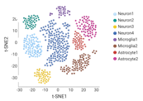

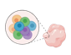
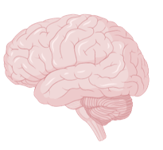
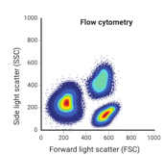
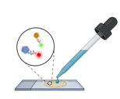
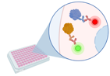
Single-cell/nucleus RNA Sequencing
Western Blot
Flow cytometry
Immunohistochemistry/immunocytochemistry
Spatial and morphology information

Slide 3
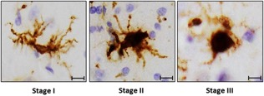
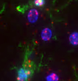
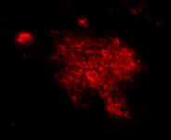
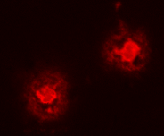
Spatial information
Morphology information
Protein/RNA expression
Pathology features

Slide 4
Need at least 2500 cells to make a profile
Grey matter: 120-150 cells/image, magnification x20
White matter: 200-300 cells/image, magnification x20
Grey matter: 20-30 images
White matter: 10 images
In Zigzag pattern to cover all layers
Ex: For 100 subjects => 3000 images per marker
=> Automating the image analysis pipeline is preferable
ImageJ / Fiji
QuPath (open-source software designed for digital pathology and bioimage analysis)
MATLAB
Ilastic (open-source software that provides a user-friendly interface for interactive image classification, segmentation, and analysis)
CellProfiler

Slide 5

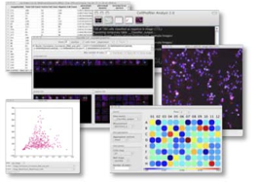
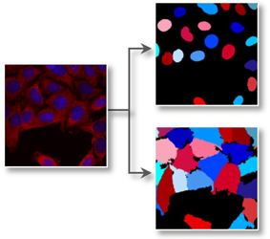
CellProfiler: open-source software designed for high-throughput image analysis
Philosophy of CellProfiler: Measure everything, ask questions later
https://cellprofiler.org/
Cell measurements
(size, shape, intensity, morphology)
Data exploration, analysis
Identification (segmentation)
Please make sure you have the right Java version on your computer

Slide 6
1- How to make a pipeline
2- How to run the pipeline
3- How to read the data

Slide 7
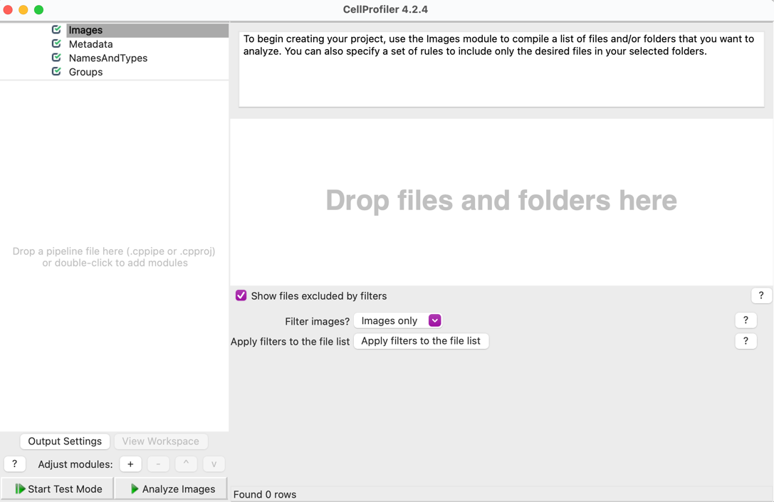
Drag and drop Images here
Images : .tiff format
Preferably grey scale

Slide 8
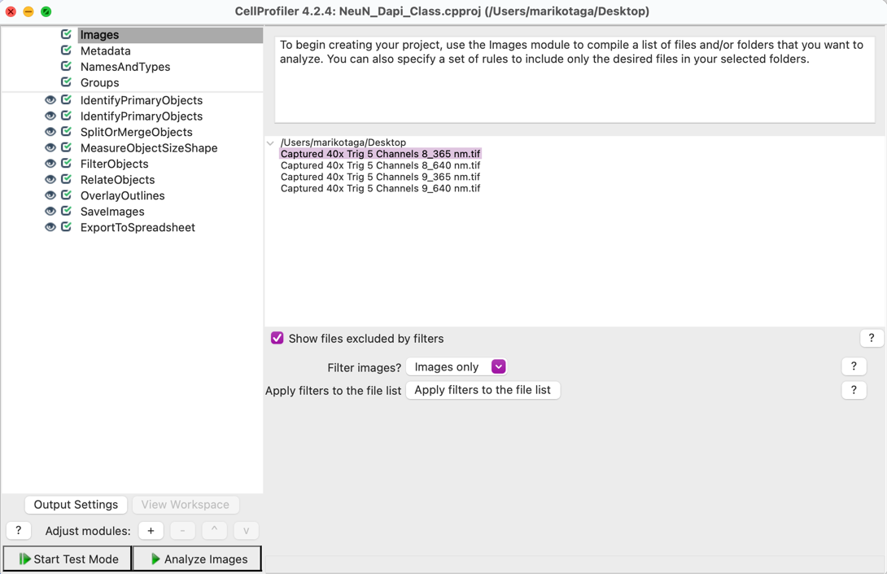
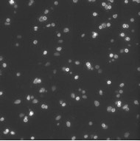
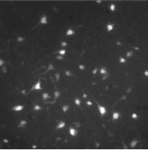
365
640
Dapi
NeuN

Slide 9
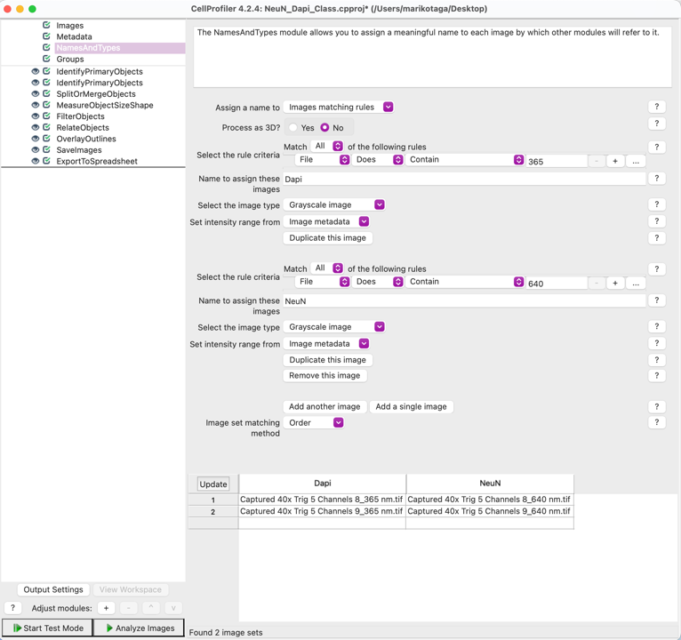
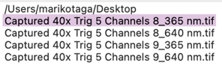
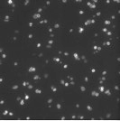
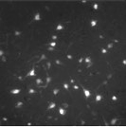
365
640
Dapi
NeuN

Slide 10
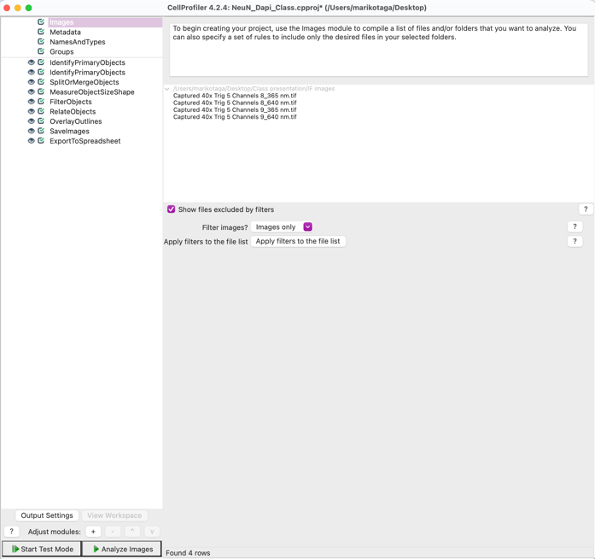
Add modules

Slide 11

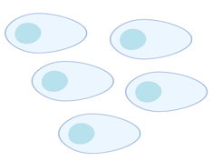
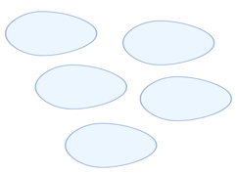
Approach 1: Define two Primary Objects
Primary Objects (Dapi)
Combined
Primary Objects (NeuN)

Slide 12
Approach 1: Define two Primary Objects
IdentifyPrimaryObjects
Primary Objects (Dapi)
Combined
Primary Objects (NeuN)

Slide 13
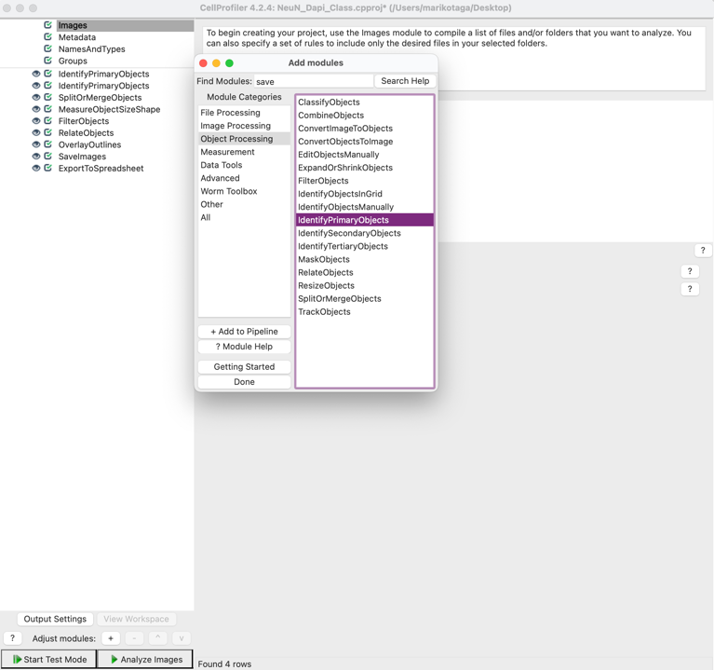
Object which is present in all cells.
Nuclei are typically primary objects

Slide 14
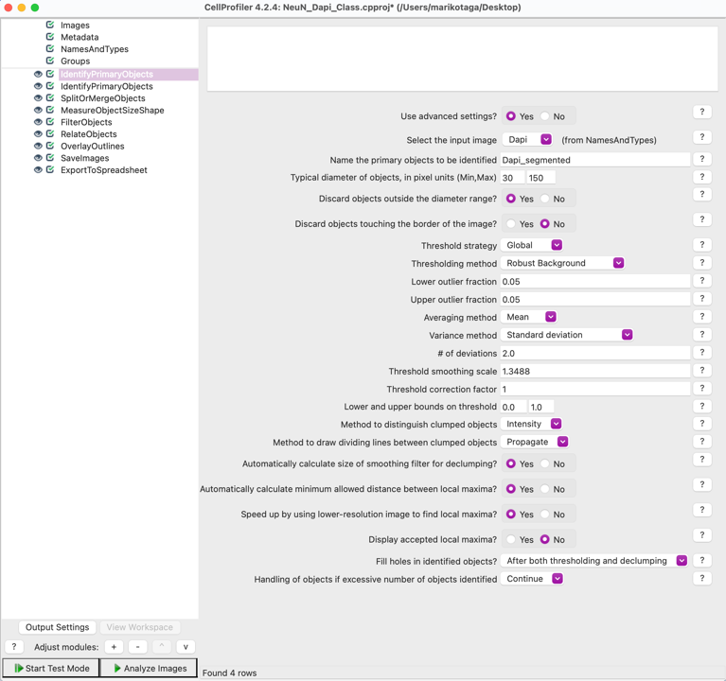
Size range of the Nuclei (magnification X40 here)
Global: Fast, good when the foreground/background is uniform
Adaptive: Slow but better result for non-uniform foreground/ background

Slide 15
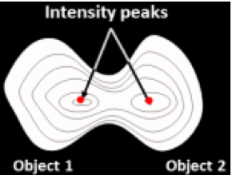
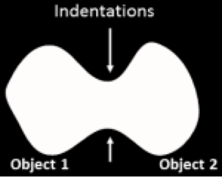
Separating touching objects
Clump Identification: By intensity or Shape
Intensity: Works best if objects are brighter at the center and dimmer at edges.
Shape: Works best if objects have indentations where clumps touch

Slide 16
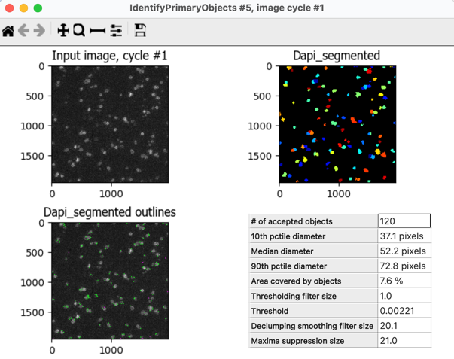
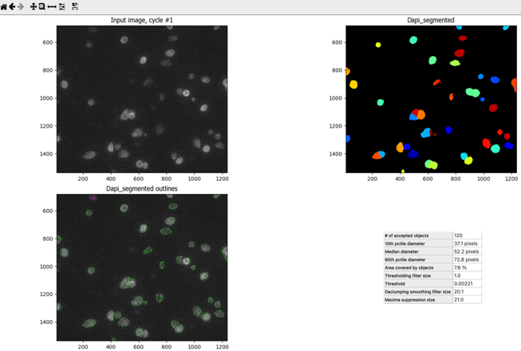
To zoom

Slide 17
Approach 1: Define two Primary Objects
Primary Objects (Dapi)
Combined
IdentifyPrimaryObjects
Primary Objects (NeuN)

Slide 18
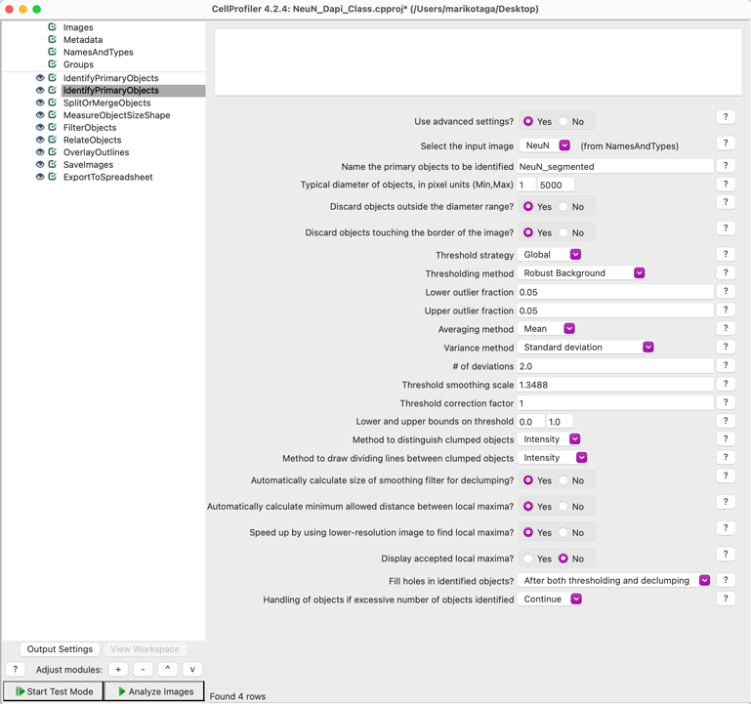
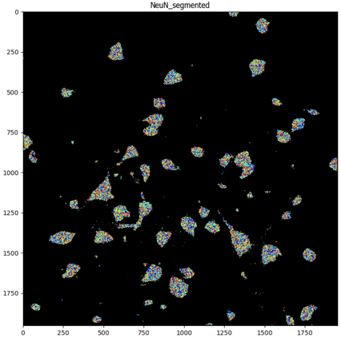
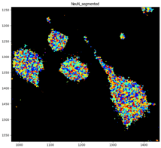
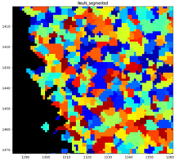

Slide 19
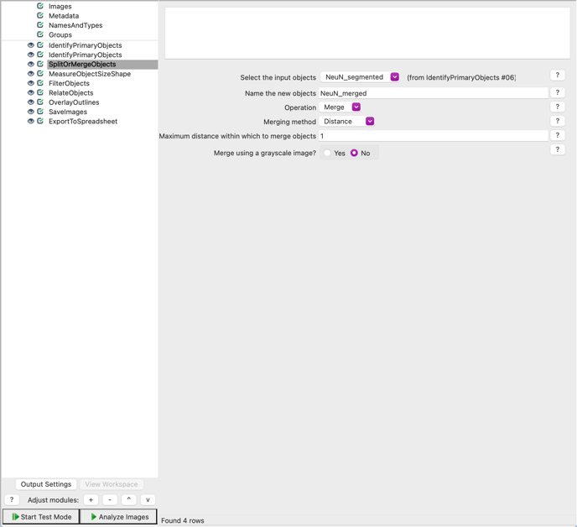
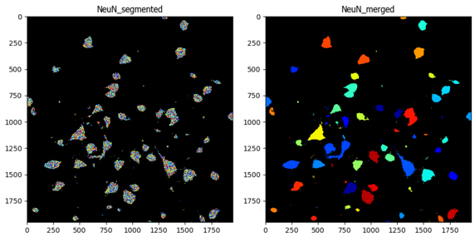
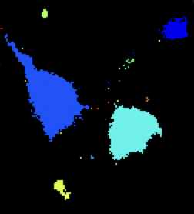
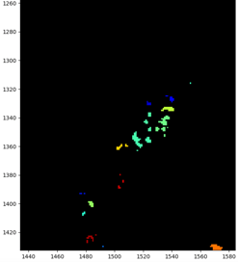
SplitOrMergeObjects separates or combines a set of objects that were identified earlier in a pipeline.

Slide 20
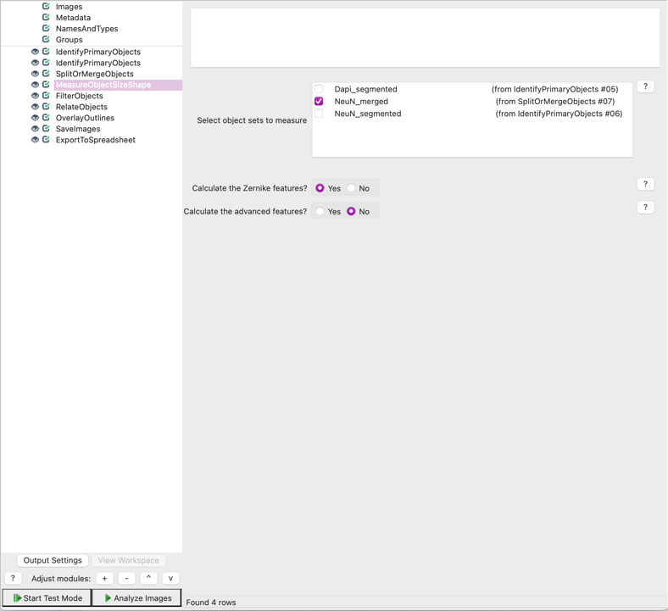
Measure the size of all objects

Slide 21
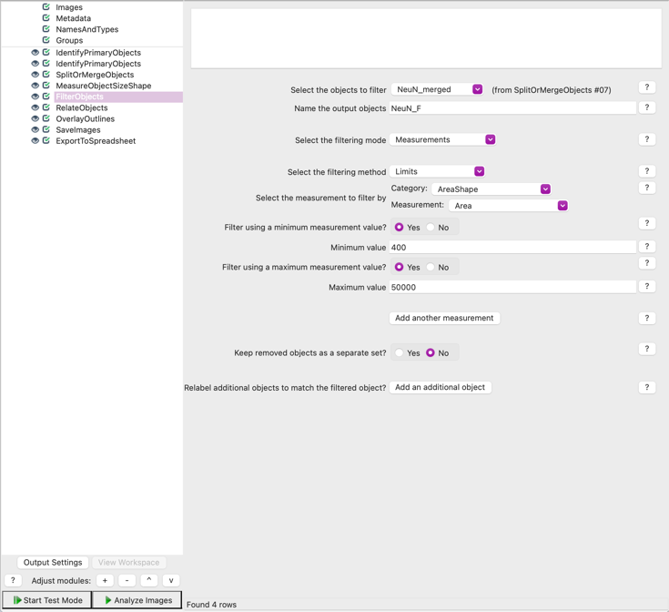
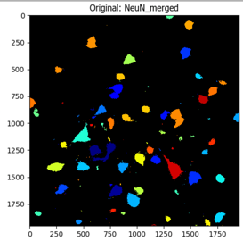
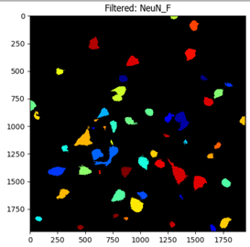
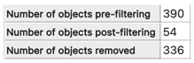
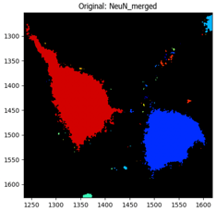
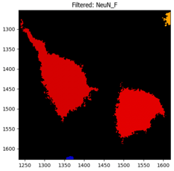

Slide 22
Approach 1: Define two Primary Objects
RelateObjects
Primary Objects (Dapi)
Combined
Primary Objects (NeuN)

Slide 23
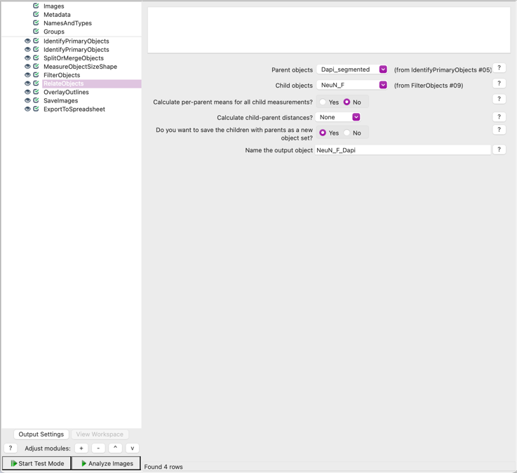
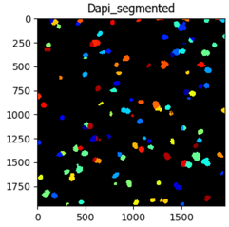
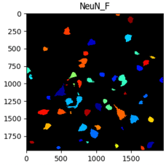
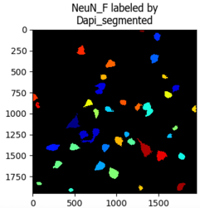

Slide 24
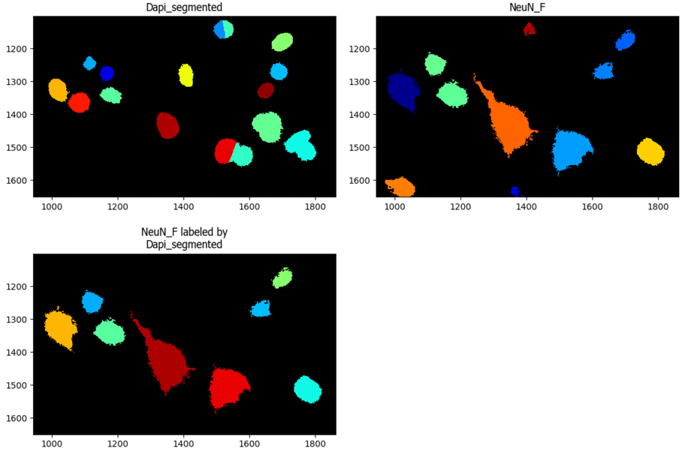

Slide 25
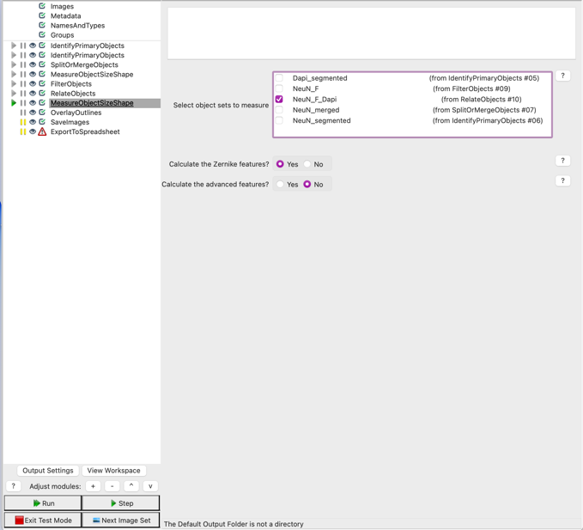

Modules for Object Measurement (Intensity, Shape)

Slide 26


Overlay Outlines + Save the outlines

Slide 27

NeuN (red) and Dapi (blue) outlines

Slide 28

Export the data

Slide 29
Approach 2: Identify a Primary Object then a Secondary Objects
+
Primary Objects (Dapi)
Secondary Objects (NeuN)
Primary Objects (Dapi)
Secondary Objects (NeuN)

Slide 30



Dapi
NeuN

Slide 31


Approach 1 vs Approach 2
Dapi
NeuN
Approach 1
Approach 2
Need to define NeuN+Dapi+ based on NeuN intensity (or cell size)
Dapi positive cells (including Dapi for all cell types) + NeuN positive cells
NeuN positive for Dapi

Slide 32



Approach 1 vs Approach 2
Approach 1
Approach 2
Blue: Dapi (Primary Objects)
Red: NeuN (Primary Objects)
Green: Dapi (Primary Objects)
Magenta: NeuN (Secondary Objects)

Slide 33
1- How to make a pipeline
2- How to run the pipeline
3- How to read the data

Slide 34


Slide 35


Test Mode

Slide 36



Slide 37
1- How to make a pipeline
2- How to run the pipeline
3- How to read the data

Slide 38


Slide 39

Dapi_segmented
112 dapi in image 1
Dapi 1 is NeuN negative
Dapi 2 is NeuN_F positive
Total: 39 Dapi are NeuN_F positive

Slide 40

NeuN_F
NeuN_F 1 is Dapi positive
NeuN_F 6 is Dapi negative

Slide 41

NeuN_F_Dapi
Total: 39 NeuN_F_Dapi (NeuN positive for Dapi)

Slide 42

https://cellprofiler-manual.s3.amazonaws.com/CellProfiler-4.0.5/modules/measurement.html

Slide 43


Measurements made by MeasureObjectSizeShape module
29 measurements
Examples:
Area: The number of pixels in the region.
Perimeter: The total number of pixels around the boundary of each region in the image.
FormFactor: Calculated as 4*π*Area/Perimeter². Equals 1 for a perfectly circular object.
Solidity: The proportion of the pixels in the convex hull that are also in the object, i.e., ObjectArea/ConvexHullArea.
Eccentricity: The eccentricity of the ellipse that has the same second-moments as the region. The eccentricity is the ratio of the distance between the foci of the ellipse and its major axis length. The value is between 0 and 1. (0 and 1 are degenerate cases; an ellipse whose eccentricity is 0 is actually a circle, while an ellipse whose eccentricity is 1 is a line segment.)
Compactness: The mean squared distance of the object’s pixels from the centroid divided by the area. A filled circle will have a compactness of 1, with irregular objects or objects with holes having a value greater than 1.

Slide 44


Eccentricity and Compactness measurements used to investigate microglia morphology
Eccentricity (0< X <1)
Compactness
(1 = or > 1)
Eccentricity = Low value
Eccentricity = High value
Compactness = Low value
Compactness = High value

Slide 45



Pilot Study: Study of microglia morphology in association with amyloid plaques
Compare shape, size and expression of target protein
Classify microglia: Microglia colocalized (pink) and non-colocalized with plaques (blue)
Dapi
Iba1
Plaque

Slide 46





Pipeline to detect microglia colocalized with amyloid plaques
Dapi segmentation
Iba1 segmentation
Aβ₁₋₄₂ segmentation
Iba1 positive for Dapi
Iba1 colocalized with plaques
Microglia with nuclei
Microglia colocalized with plaques

Slide 47




Many existing pipelines online!
https://cellprofiler.org/examples

Slide 48
Thank You and Good Luck!!

Slide 49
CellProfiler: Workshop
Genomics and Machine Learning in Neuroscience

Slide 50
Count the number of NeuN+Dapi+ cells
Load two Images (channels 365, 640) in “Images”
Define names and types in “NamesAndTypes”
Identify Primary Objects (Dapi) – Define the Diameter of objects, the threshold strategy, the thresholding method, distinguish clumped objects
Identify Primary Objects (NeuN) - Define the Diameter of objects, the threshold strategy, the thresholding method, and distinguish clumped objects
Merge NeuN objects using SplitOrMergeObjects module:
- input objects: NeuN_segmented
- Operation: Merge
- Merging method: Distance
- Maximum distance within which to merge objects: 1
6. Measure the NeuN size shape using the “MeasureObjectSizeShape” module
7. Remove small non specific NeuN objects using the “FilterObjetcs” module (Category: AreaShape, measurement: Area)
8. Create NeuN+Dapi+ objects by using the “RelateObjects” module
9. Create NeuN+Dapi+ outlines images using the “OverlayOutlines” module
10. Save the Overlay Outlines images for NeuN+Dapi+.
11. Export the spreadsheet using “ExportToSpreadsheet” module
12. Analyze Images

